Slide 1
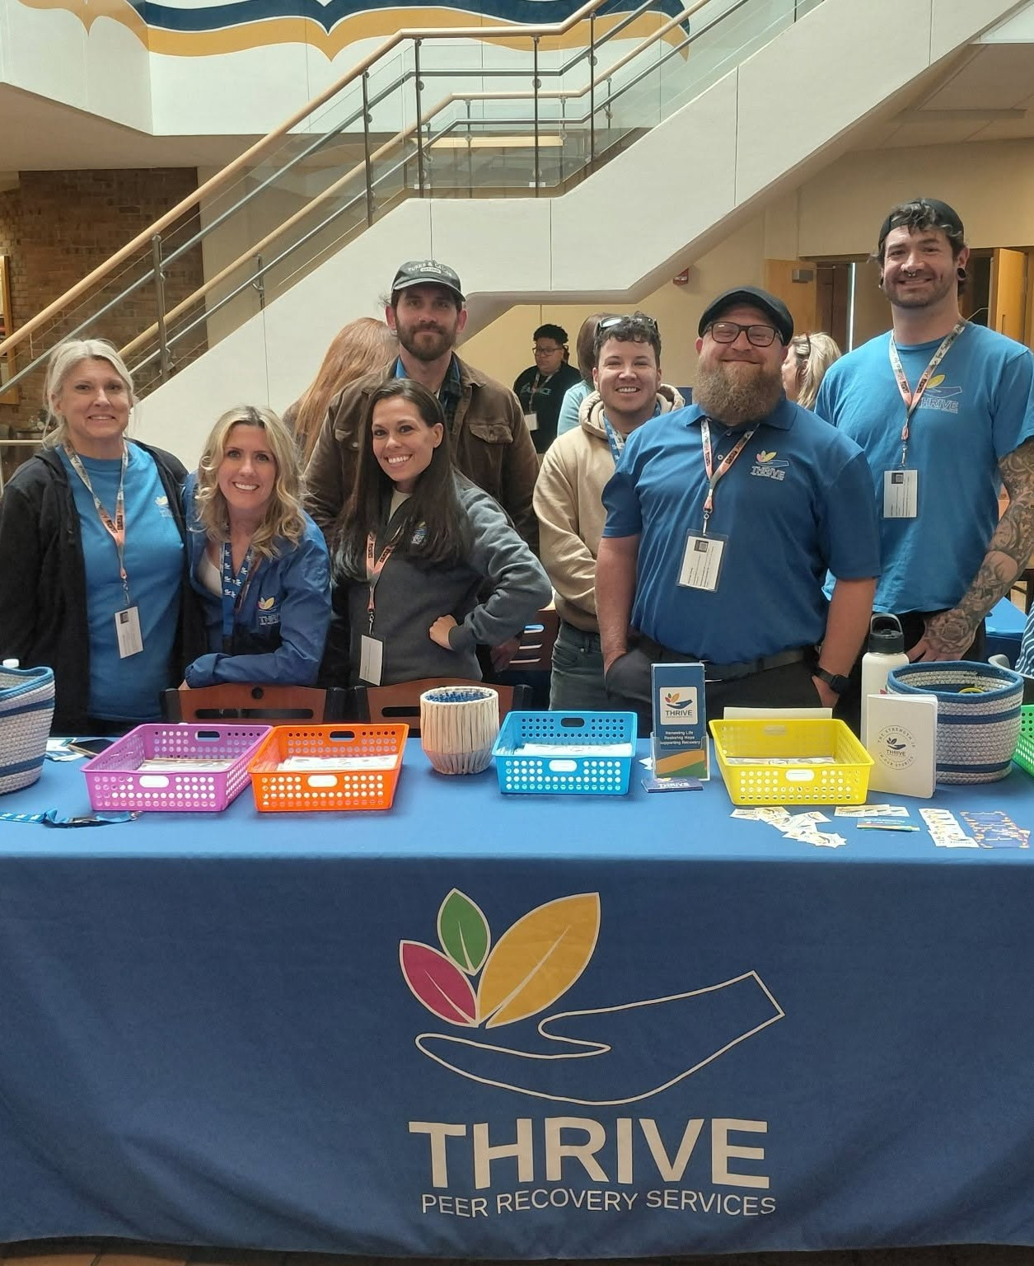


Thrive Peer Recovery Services
From crisis to community, a peer at every step.
MISSION-DRIVEN. BUILT TO THRIVE.

Slide 2




ABOUT THRIVE
Built from lived experience
Thrive was founded by CEO Brian Bailys, built from his own experience in treatment and recovery and the challenges he noticed in aftercare.
Today we deliver substance use and mental health peer recovery support across Ohio, empowering individuals on their journey by embracing all pathways to recovery that foster community engagement, trusting relationships, and personal growth.
25,000+
2017
Ohioans served since inception
Providing peer support since
CARF Accredited
DBH Certified
150+
SUD + MH
Medicaid Enrolled
Licensed for 24/7
Staff, 90% in recovery
Substance use and mental health peer support
MISSION-DRIVEN. BUILT TO THRIVE.
THRIVE PEER RECOVERY SERVICES
2

Slide 3





WHERE WE SERVE
Peer support at every point of entry
Community programs
Jails and reentry
Specialty courts
Crisis services
Hospitals
Meeting people where they live and staying connected after treatment.
Engagement before and after release to support a stable return home.
Recovery support that helps participants meet court requirements.
Crisis center peer staffing and prior MRSS contract experience.
ED and inpatient peer support with warm handoffs at discharge.
One partner, start to finish: continuity from first contact to long term recovery
MISSION-DRIVEN. BUILT TO THRIVE.
THRIVE PEER RECOVERY SERVICES
3

Slide 4



BEYOND DIRECT SERVICE
Infrastructure boards can rely on
Project management
A KEY FOCUS
Structured planning, launch, and reporting for new programs and contracts.
Compliance, utilization management and FWA prevention
Documentation standards and audit readiness
Training and internships
Utilization management and billing integrity
Peer training, supervision, and an internship pipeline for the next generation of certified peers.
Fraud, waste and abuse prevention built into daily operations
We protect the investment your community makes in recovery.
MISSION-DRIVEN. BUILT TO THRIVE.
THRIVE PEER RECOVERY SERVICES
4

Slide 5




WHY THRIVE, WHY NOW
Peer support is more essential than ever
Medicaid is changing
Federal funding is unstable
Work requirements and more eligibility checks put people in recovery at risk of losing coverage.
Abrupt grant cancellations leave providers unsure what they can count on.
Ohio is tightening access
Local systems are stretched
Work requirements by January 2027, and a trigger law tied to federal funding.
Providers are cutting programs, waitlists are growing, and county Boards are absorbing shortfalls.
Peer support fills the gap
Community-based, cost-effective and grounded in lived experience.
Thrive is well positioned
A proven model, a trained peer workforce and established community partnerships.
MISSION-DRIVEN. BUILT TO THRIVE.
THRIVE PEER RECOVERY SERVICES
5

Slide 6


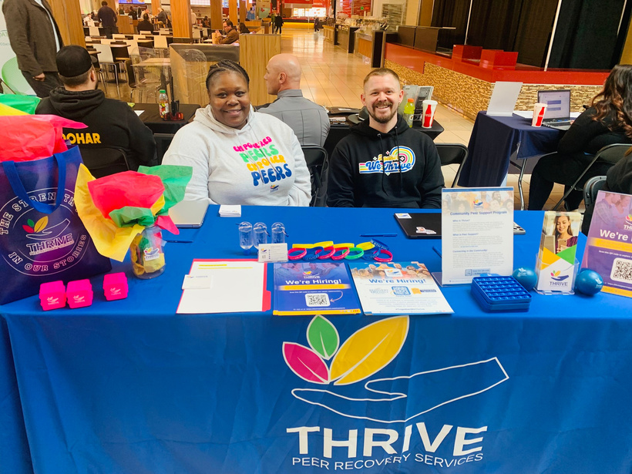
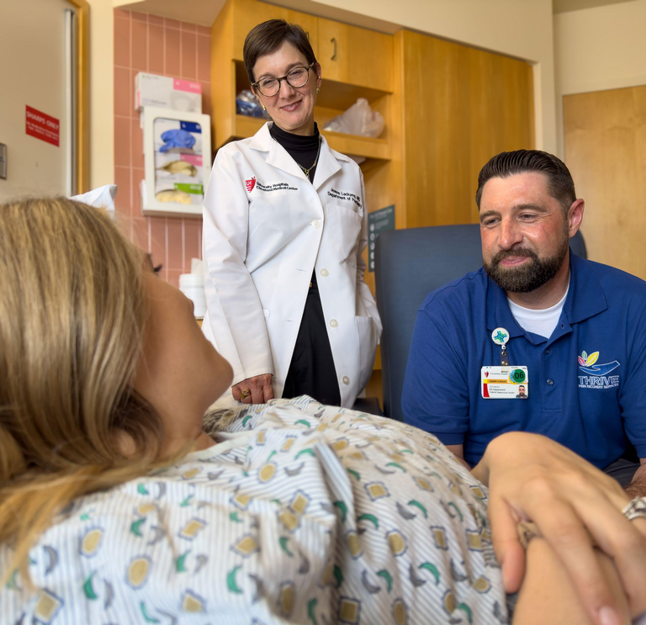

We would love to connect about opportunities for collaboration.
Justin Larson, VP of Engagement and Relations jlarson@thrivepeersupport.com
216-220-8774 x 709
Scan to connect with our team
Share your contact info and sign up for our quarterly newsletter.
www.ThrivePeerSupport.com
THRIVE PEER RECOVERY SERVICES

